Slide 1
Teen Brain Development & Social Media
Authors

Slide 2
Welcome!
Speaker: Miss. Julianne- HHS Social Worker
Room: H127D
Volunteer/Extra Credit forms passed out at the end
I would like to meet you!
Your name, grade, something you like or dislike about social media?
Expectations:
Be respectful
Phones for emergency only
No side chatter
Be supportive to one another

Slide 3
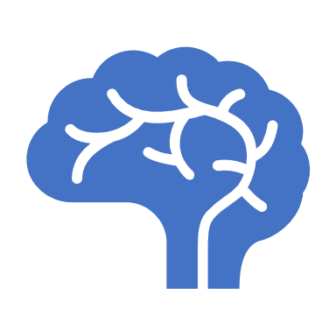
What’s going on inside my brain right now?
Video: Teen Brain HD

Slide 4
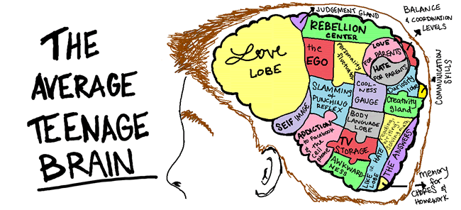
Facts About the Teenage Brain
New Thinking Skills
- Increase in brain matter, interconnected and gains processing power
-Start to be able to make decisions like an adult (but can be influenced by emotions since the prefrontal cortex is not fully developed)
Intense Emotions
-Due to hormonal changes and changes in the limbic system, may rise intense experiences of rage, fear, aggression, excitement, and attraction
Peer Pleasure
-Peer approval has been shown to be highly rewarding in the teen brain
-Teens are more likely to take risks when other teens are around
Measuring Risk
-Teens need higher doses of risk to feel the same amount of rush adults do due to the development of the prefrontal cortex
-May make teens vulnerable to engaging in risky behaviors
-Parents should be there to limit those risky behaviors
“I am the Center of the Universe”
-Hormonal changes at puberty have a huge impact on the brain, linking to feeling self conscious (making an adolescent feeling like everyone is watching him or her)
-Feelings peak around 15 years old
-First time seeing self in the world. Example: Asking self What kind of person do I want to be and what type of place do I want the world to be?
This Photo by Unknown Author is licensed under CC BY

Slide 5
Is it me too?
Do you ever say something that came out of nowhere?
Do you ever say something without thinking?
Do you ever feel like your parents don’t understand you?
Do you ever feel extreme peer pressure?
Do you ever feel like your emotions are out of control?
Do you ever take big risks?
Do you have trouble waking up/falling asleep?
Then you might have a case of the…TEENAGE BRAIN!!!
This too shall pass…eventually.

Slide 7
Pros & Cons to Social Media Activity

Slide 8
Digital Footprint
What is it?
It's what's left behind as you casually browse the web, post on social media or even type into a chat service. The websites you visit, the news posts you comment on, the comments you leave on social media platforms— each of these items come together to create a portrait of your online life.
Social Media is not going away!
How to Improve Your digital footprint
Be smart when Web Browsing
Don’t visit sites that make you nervous or unsure what you are looking at
Turn on your Social Media Privacy
Approve only people you know
Be responsible on Socia Media
Don’t disclose personal information & think before you post

Slide 9
Research on the Brain & Social Media
Notes:
https://youtu.be/7RY3gSdKRn0

Slide 10
How does social media influence teenagers’ brain development?
Peer acceptance or rejection important role in adolescent developmental stage; must look at social media use
Teens have elevated emotional sensitivity; paired with acceptance or rejection in social media platforms may cause teens to be especially reactive to emotion-arousing media
Increased activity in orbitofrontal cortex (decision-making), insula (processes bodily sensations & emotional experience), and dorsal anterior cingulate cortex (empathy, impulse control, and emotion) areas in the brain during exclusion or rejection over social media, which can indicate negative emotions
Behaviors can adjust depending on positive or negative peer feedback (profile pics/music preference)
Future research: differences in how various social media is perceived (popular, sensationalist, fake, etc.) and what causes heighted emotional arousal
Future research: Possibility of need for emotional control/regulation training in video games or other immersive online environments → coping strategies, calming techniques, behavioral control, and dealing with anxiety or stress
Need for more research as the long-term brain developmental outcomes are scarce

Slide 11
How can social media affect teenagers’ mental health?
The Upsides
The Downsides
Good source for socialization in the teenage years
People who struggle w/ social skills or social anxiety might benefit from connecting through social media
Keeps the line of communication open with others
Can bring attention to current issues in society or form online communities
Teens can find support and friendships through supportive online groups
Can include teens in marginalized groups
Focus is on number of likes
Can lead to cyberbulling
Making comparisons
“Fake friends”
Less in-person face time
Sleep deprivation
Possibility of anxiety-inducing situations
Social media activity (self-reported frequency of checking accounts & number of accounts) is “positively related to FoMO and loneliness”; also related to “parent-reported hyperactivity/impulsivity, anxiety, and depression” (Barry, Sidoti, Briggs, Reiter, & Lindsey, pg. 8).

Slide 12
Social Media

Slide 13
What do I do with this information?
Below are some things teenagers can do if they wish to help control the way in which social media affects their development/mental health.
Set limits to own social media use
Turn off phone before going to bed and/or stop use awhile before bed
Keep focus on in-person relationships
Make more time for social interactions
Remember – social media is not reality and peer rejection is not the end of the world (even though it can sometimes feel like it)
Set time aside for routine self-care strategies or doing things you enjoy

Slide 14
Social Media Fast
Notes:
https://youtu.be/gM3KIvZO5oU

Slide 15
Questions/Comments?
Thank you for coming!
Notes:
https://www.youtube.com/watch?v=dRl8EIhrQjQ

Slide 16
References
Barry, C., Sidoti, C., Briggs, S., Reiter, S., & Lindsey, R. (2017). Adolescent social media use and mental health from adolescent and parent perspectives. Journal of Adolescence, 61(1), 1-11. Retrieved from https://www-sciencedirect-com.ezproxy1.lib.asu.edu/science/article/pii/S0140197117301318
Crone, E. & Konjin, E. (2018). Media use and brain development during adolescence. Nature Communications, 9(1), 1-10. doi: 10.1038/s41467-018-03126-x
Hurley, K. (2019). Social media and teens: How does social media affect teenagers’ mental health. Retrieved from https://www.psycom.net/social-media-teen-mental-health

